Slide 1
NODE
JS
Md Abdul Ahad Linkon - Software Engineer
12/ 2025
JOIN US

Slide 2
TABLE OF CONTENT
Internet
Frontend Basics
LANGUAGE
Version Control Systems
Repo Hosting Services
Relational Databases
APIs
Caching
Web Servers
Databases
Testing
Docker
More - (Architectural Patterns, Design and Architecture, System design, Real time data)
Scaling database
non-sql database

Slide 3
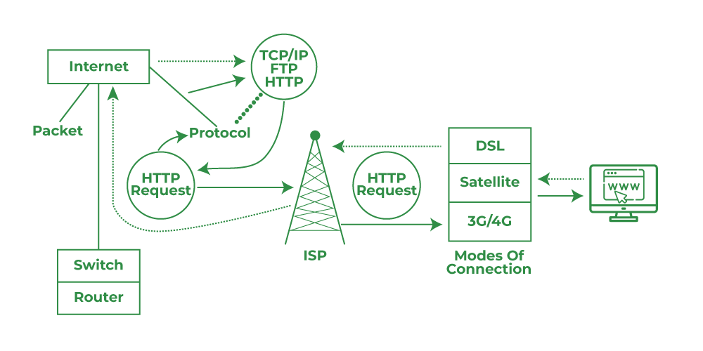
How does the Internet Work?
Internet
OBJECT 01
The internet is a global network of interconnected computers that uses a standard set of communication protocols to exchange data.
https://cs.fyi/guide/how-does-internet-work | https://www.youtube.com/watch?v=x3c1ih2NJEg

Slide 4
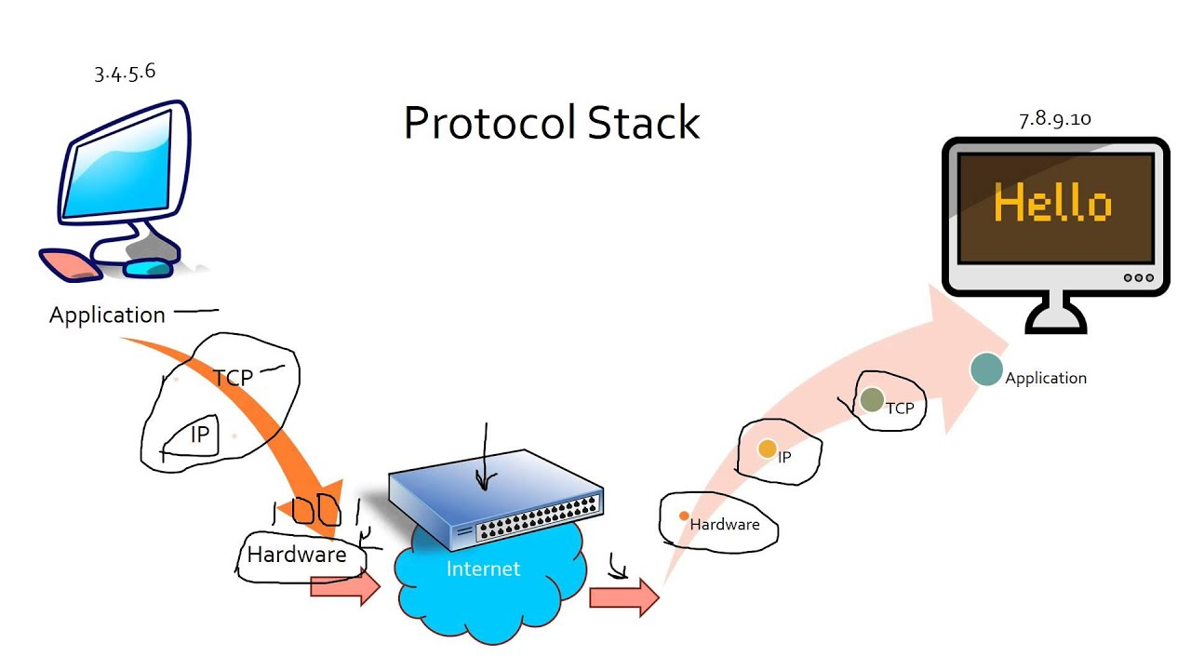

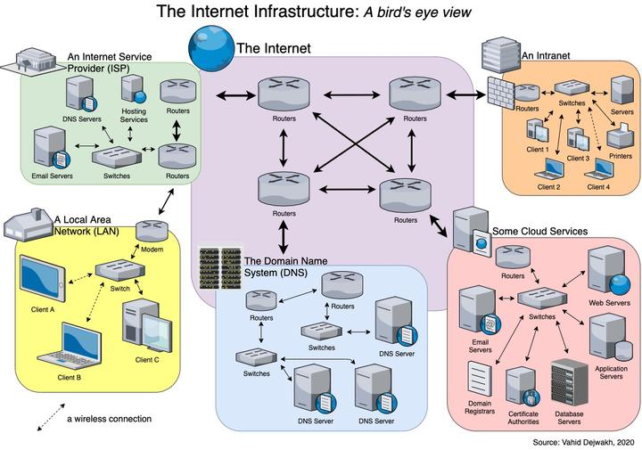
The basic concept of Intern:
Internet
OBJECT 02
Answer.To understand the internet, it’s important to be familiar with some basic concepts and terminology. Here are some key terms and concepts to be aware of:
Packet , router,
ip address,
domain name, dns,
http, https, ssl, tsl

Slide 5
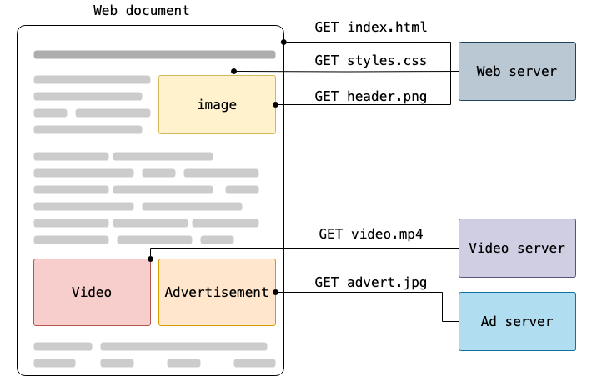
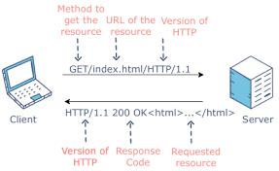
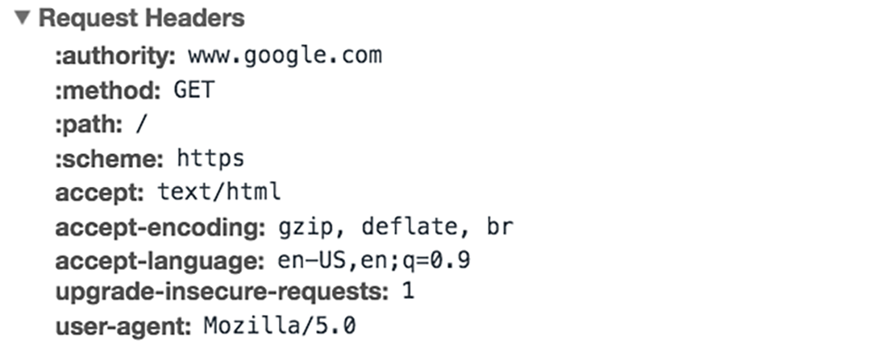
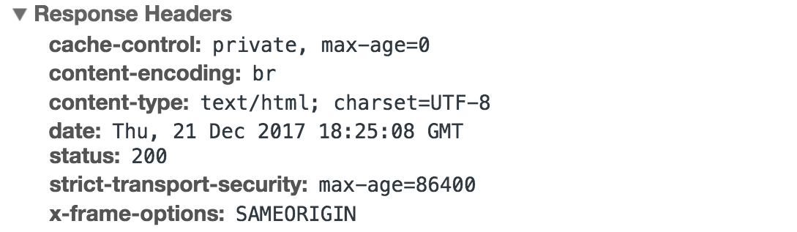
What is HTTP
Internet
The Hypertext Transfer Protocol (HTTP) is the foundation of the World Wide Web, and is used to load webpages using hypertext links. HTTP is an application layer protocol designed to transfer information between networked devices and runs on top of other layers of the network protocol stack. A typical flow over HTTP involves a client machine making a request to a server, which then sends a response message.
https://developer.mozilla.org/en-US/docs/Web/HTTP/Guides/Overview

Slide 6
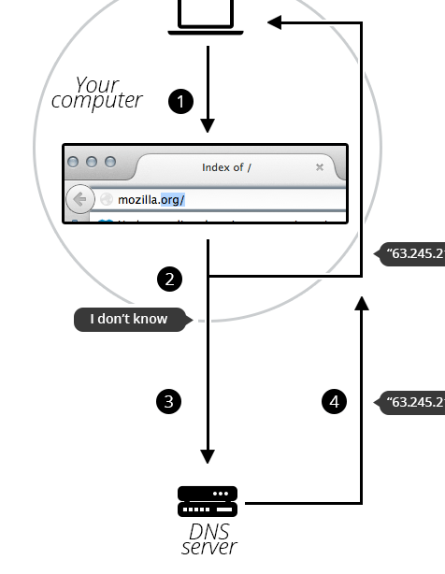
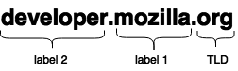
What is a Domain Name?
Structure of domain names
https://developer.mozilla.org/en-US/docs/Learn_web_development/Howto/Web_mechanics/What_is_a_domain_name#structure_of_domain_names
TLDs tell users the general purpose of the service behind the domain name. The most generic TLDs (.com, .org, .net) don't require web services to meet any particular criteria, but some TLDs enforce stricter policies so it is clearer what their purpose is. For example:
Local TLDs such as .us, .fr, or .se can require the service to be provided in a given language or hosted in a certain country — they are supposed to indicate a resource in a particular language or country.
TLDs containing .gov are only allowed to be used by government departments.
The .edu TLD is only for use by educational and academic institutions.

Slide 7
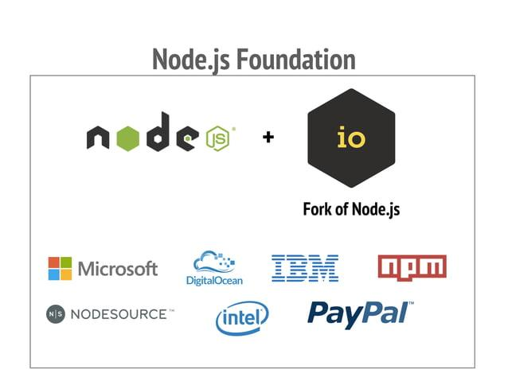

Slide 8
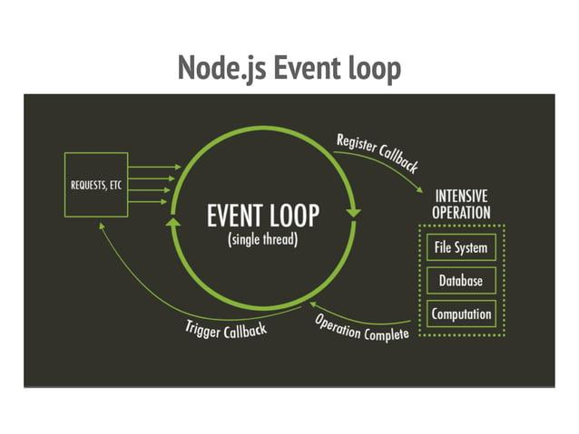

Slide 9
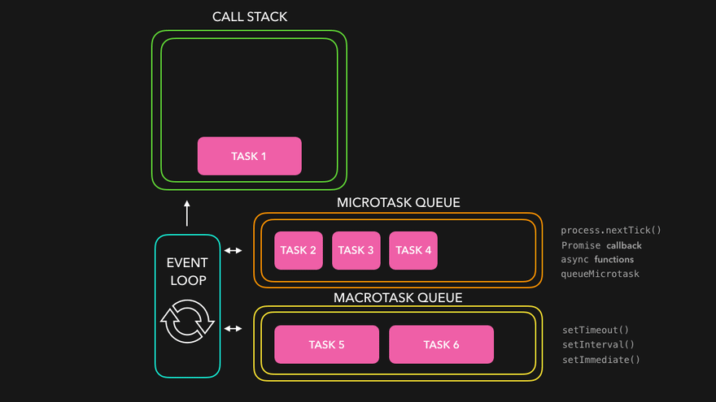

Slide 10
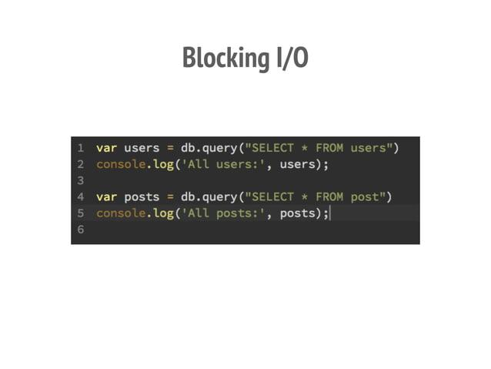

Slide 11
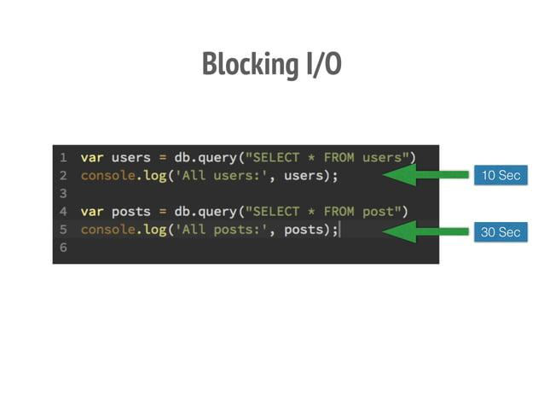

Slide 12
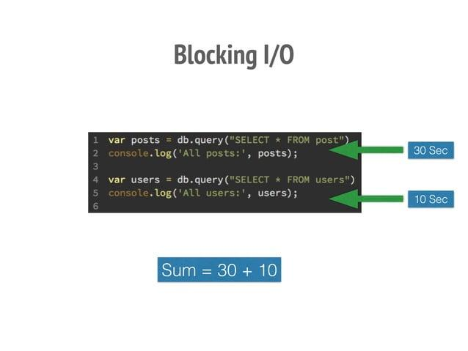

Slide 13
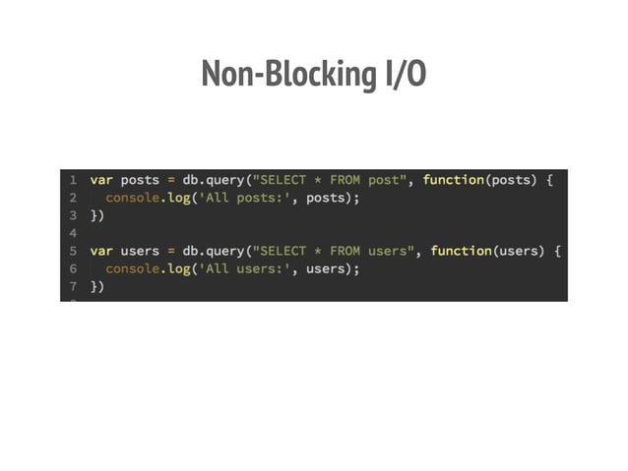

Slide 14
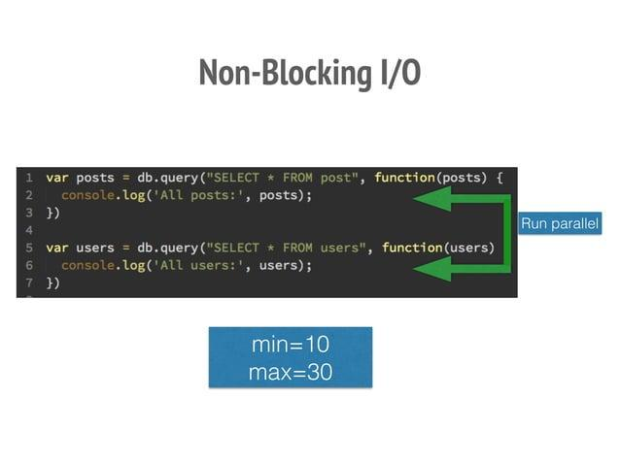

Slide 15
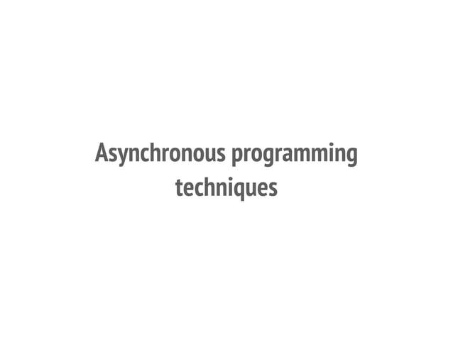

Slide 16
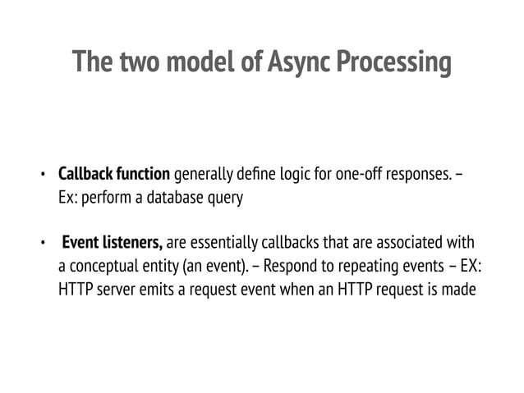

Slide 17
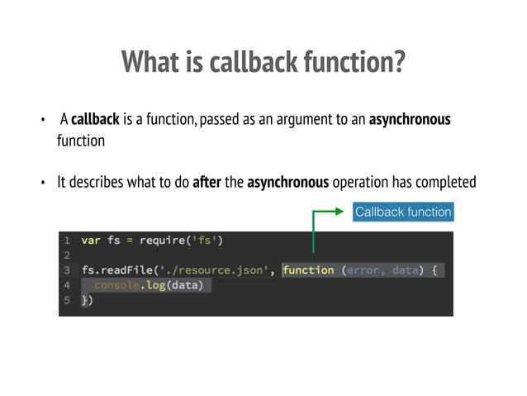

Slide 18
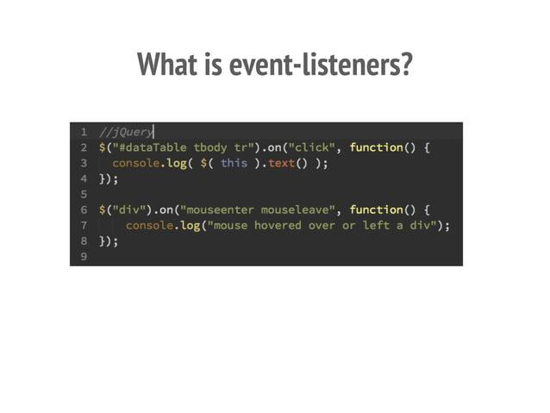

Slide 19
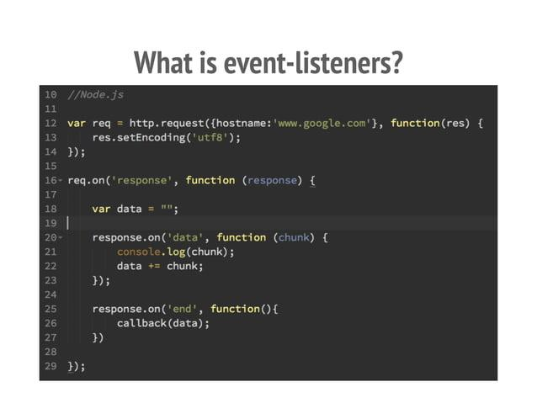

Slide 20
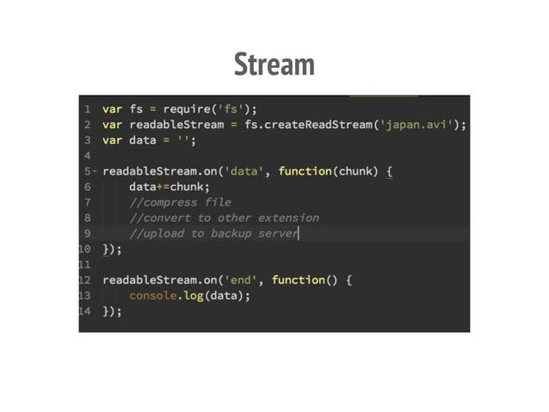

Slide 21
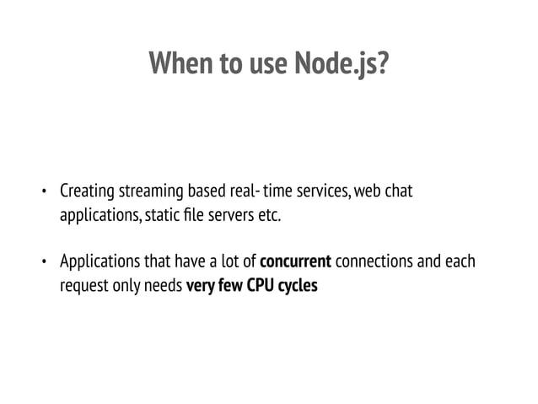

Slide 22
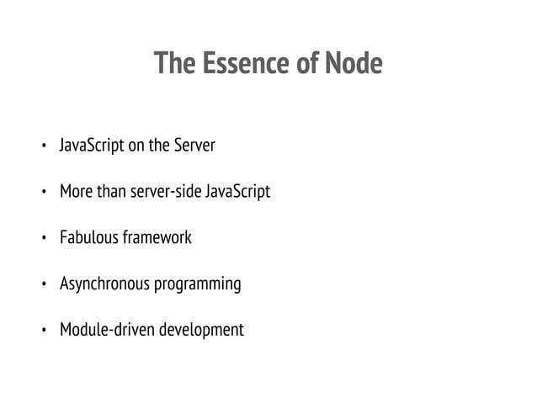

Slide 23
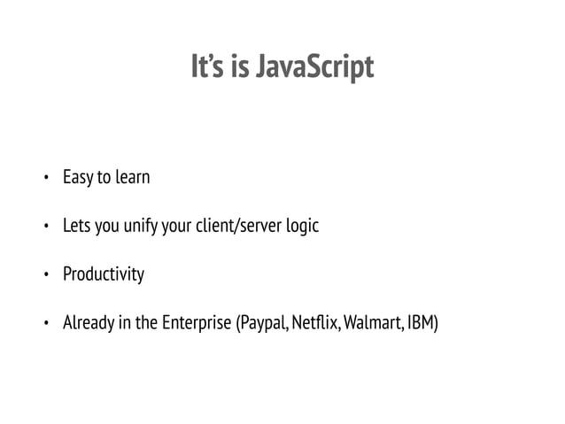

Slide 24
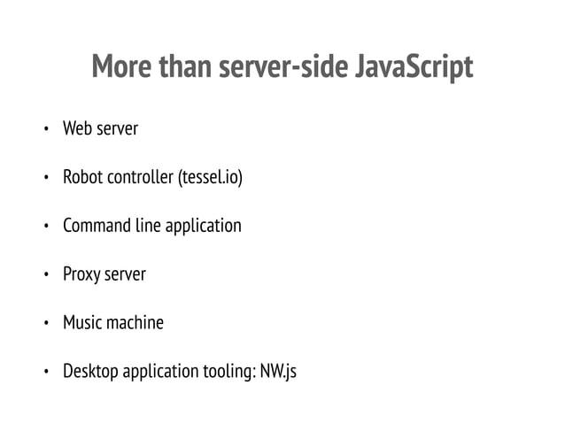

Slide 25
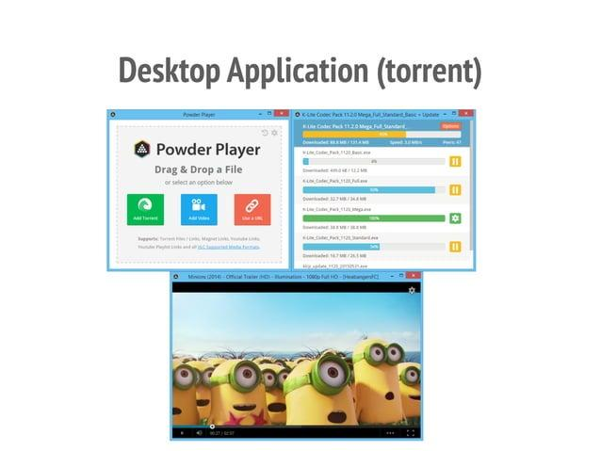

Slide 26
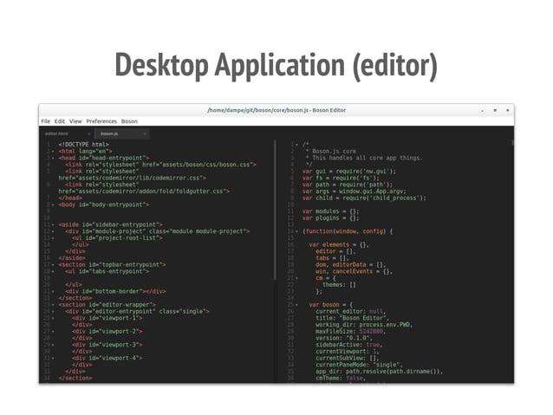

Slide 27
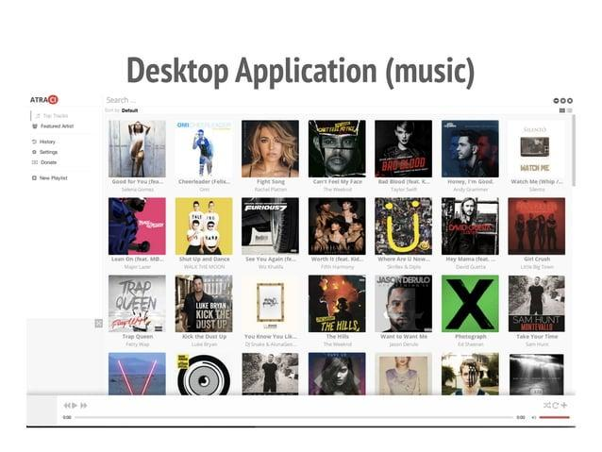

Slide 28
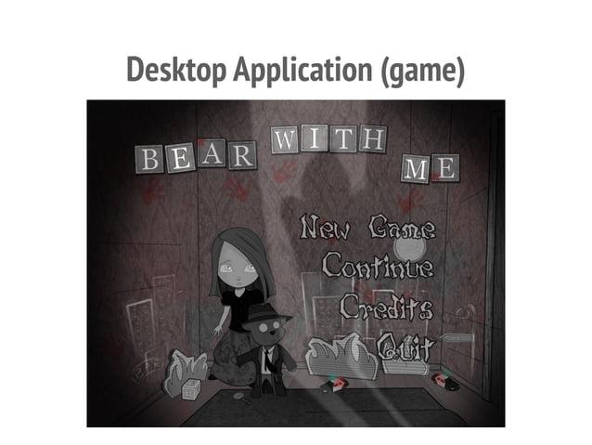

Slide 29
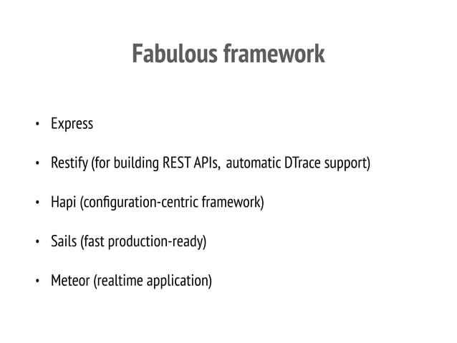

Slide 30
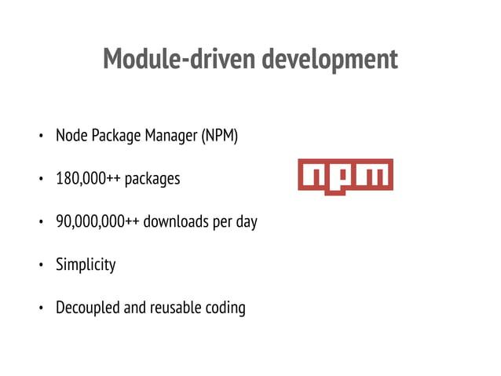

Slide 31
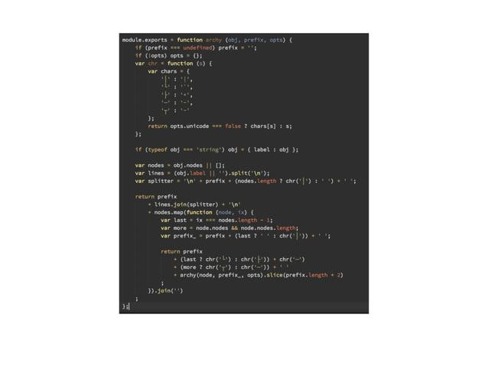

Slide 32
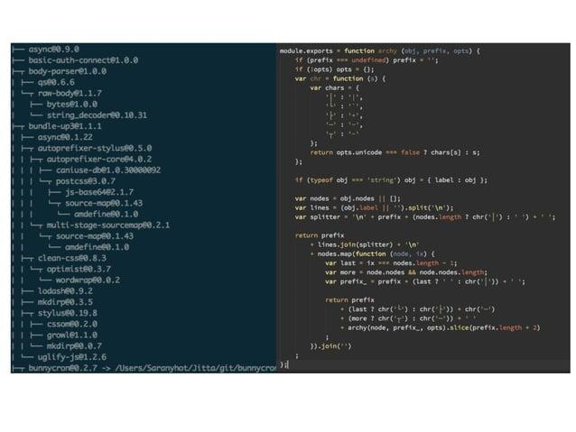

Slide 33
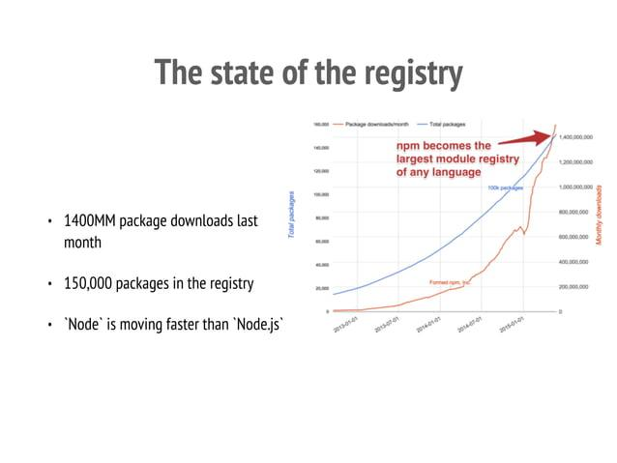

Slide 34
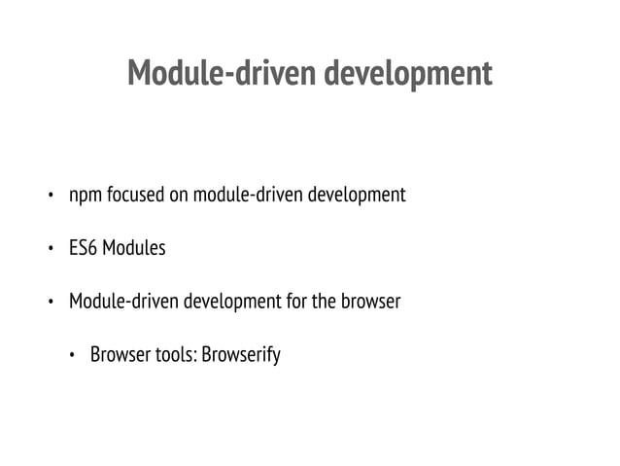

Slide 35
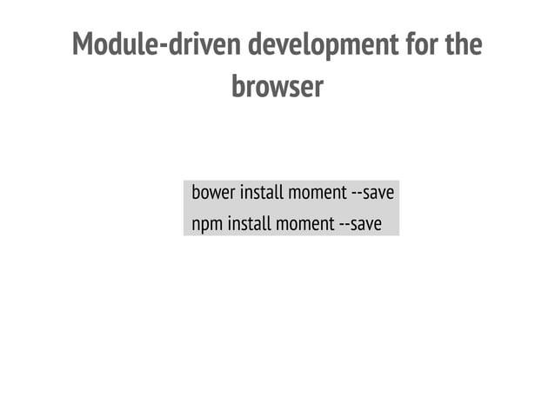

Slide 36


Slide 37
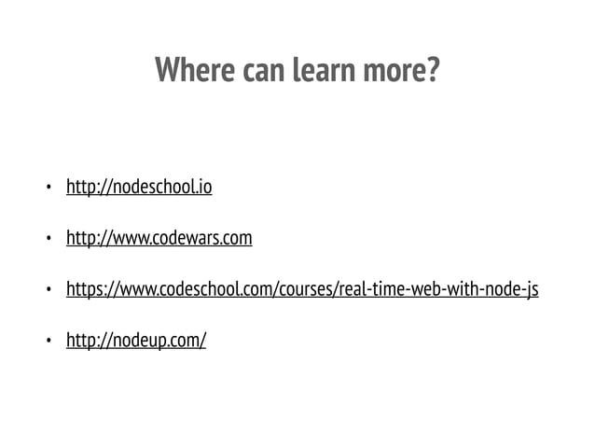

Slide 38
HOW TO JOIN
SKATE CLUB

Slide 39





THANK
YOU
SKATE CLUB

